Slide 1

William Stallings Computer Organization and Architecture 9th Edition
Notes:
Lecture slides prepared for “Computer Organization and Architecture”, 9/e, by William Stallings, Chapter 12 “Instruction Sets: Characteristics and Functions”.

Slide 2
Chapter 12
Instruction Sets:
Characteristics and Functions
Notes:
Much of what is discussed in this book is not readily apparent to the user or programmer of a computer. If a programmer is using a high-level language, such as Pascal or Ada, very little of the architecture of the underlying machine is visible.
One boundary where the computer designer and the computer programmer can view the same machine is the machine instruction set. From the designer’s point of view, the machine instruction set provides the functional requirements for the processor: implementing the processor is a task that in large part involves implementing the machine instruction set. The user who chooses to program in machine language (actually, in assembly language; see Appendix B) becomes aware of the register and memory structure, the types of data directly supported by the machine, and the functioning of the ALU.
A description of a computer’s machine instruction set goes a long way toward explaining the computer’s processor. Accordingly, we focus on machine instructions in this chapter and the next.

Slide 3
Machine Instruction Characteristics
The operation of the processor is determined by the instructions it executes, referred to as machine instructions or computer instructions
The collection of different instructions that the processor can execute is referred to as the processor’s instruction set
Each instruction must contain the information required by the processor for execution
Notes:
2
The operation of the processor is determined by the instructions it executes, referred to as machine instructions or computer instructions. The collection of different instructions that the processor can execute is referred to as the processor’s instruction set.
Each instruction must contain the information required by the processor for execution.

Slide 4
Elements of a Machine Instruction
Operation code (opcode)
Specifies the operation to be performed. The operation is specified by a binary code, known as the operation code, or opcode
Source operand reference
The operation may involve one or more source operands, that is, operands that are inputs for the operation
Result operand reference
The operation may produce a result
Next instruction reference
This tells the processor where to fetch the next instruction after the execution of this instruction is complete
Notes:
• Operation code: Specifies the operation to be performed (e.g., ADD, I/O). The operation is specified by a binary code, known as the operation code, or opcode.
• Source operand reference: The operation may involve one or more source operands, that is, operands that are inputs for the operation.
• Result operand reference: The operation may produce a result.
• Next instruction reference: This tells the processor where to fetch the next instruction after the execution of this instruction is complete.

Slide 5
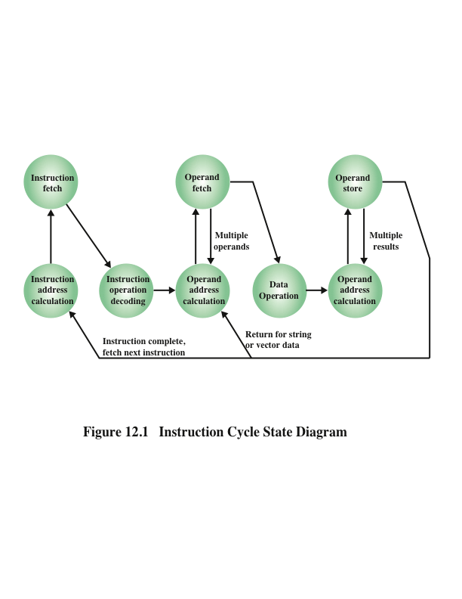
Instruction Cycle State Diagram
Notes:
3
Figure 12.1, which repeats Figure 3.6, shows the steps involved in instruction execution and, by implication, defines the elements of a machine instruction.
The address of the next instruction to be fetched could be either a real address or a virtual address, depending on the architecture. Generally, the distinction is transparent to the instruction set architecture. In most cases, the next instruction to be fetched immediately follows the current instruction. In those cases, there is no explicit reference to the next instruction. When an explicit reference is needed, then the main memory or virtual memory address must be supplied. The form in which that address is supplied is discussed in Chapter 13.

Slide 6
Source and result operands can be in one of four areas:
Processor register
A processor contains one or more registers that may be referenced by machine instructions.
If more than one register exists each register is assigned a unique name or number and the instruction must contain the number of the desired register
Main or virtual memory
As with next instruction references, the main or virtual memory address must be supplied
I/O device
The instruction must specify the I/O module and device for the operation. If memory-mapped I/O is used, this is just another main or virtual memory address
Immediate
The value of the operand is contained in a field in the instruction being executed
Notes:
4
Source and result operands can be in one of four areas:
Main or virtual memory: As with next instruction references, the main or virtual memory address must be supplied.
Processor register: With rare exceptions, a processor contains one or more registers that may be referenced by machine instructions. If only one register exists, reference to it may be implicit. If more than one register exists, then each register is assigned a unique name or number, and the instruction must contain the number of the desired register.
Immediate: The value of the operand is contained in a field in the instruction being executed.
I/O device: The instruction must specify the I/O module and device for the operation. If memory-mapped I/O is used, this is just another main or virtual memory address.

Slide 7
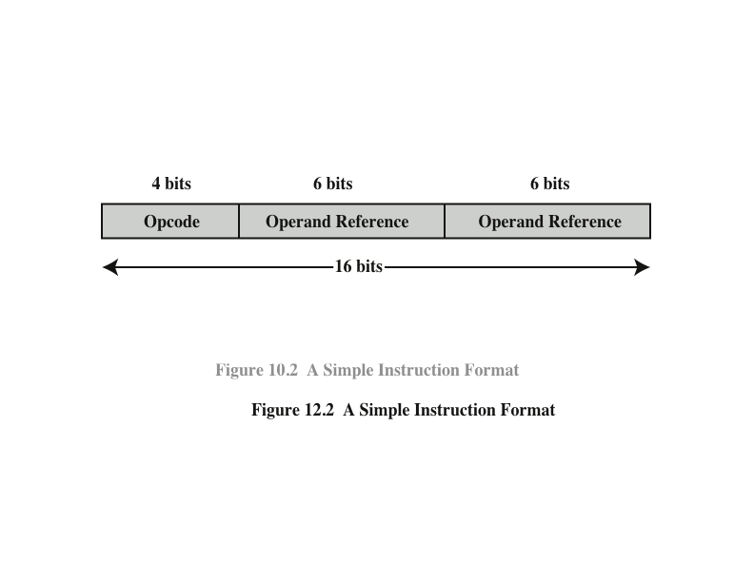
Instruction Representation
Within the computer each instruction is represented by a sequence of bits
The instruction is divided into fields, corresponding to the constituent elements of the instruction
Notes:
5
Within the computer, each instruction is represented by a sequence of bits. The instruction is divided into fields, corresponding to the constituent elements of the instruction.
A simple example of an instruction format is shown in Figure 12.2. As another example, the IAS instruction format is shown in Figure 2.2. With most instruction sets, more than one format is used. During instruction execution, an instruction is read into an instruction register (IR) in the processor. The processor must be able to extract the data from the various instruction fields to perform the required operation.
It is difficult for both the programmer and the reader of textbooks to deal with binary representations of machine instructions. Thus, it has become common practice to use a symbolic representation of machine instructions. An example of this was used for the IAS instruction set, in Table 2.1.

Slide 8
Instruction Types
Data processing
Arithmetic instructions provide computational capabilities for processing numeric data
Logic (Boolean) instructions operate on the bits of a word as bits rather than as numbers, thus they provide capabilities for processing any other type of data the user may wish to employ
Data storage
Movement of data into or out of register and or memory locations
Data movement
I/O instructions are needed to transfer programs and data into memory and the results of computations back out to the user
Control
Test instructions are used to test the value of a data word or the status of a computation
Branch instructions are used to branch to a different set of instructions depending on the decision made
Notes:
6
A computer should have a set of instructions that allows the user to formulate any data processing task. Another way to view it is to consider the capabilities of a high-level programming language. Any program written in a high-level language must be translated into machine language to be executed. Thus, the set of machine instructions must be sufficient to express any of the instructions from a high-level language. With this in mind we can categorize instruction types as follows:
Data processing: Arithmetic and logic instructions
Data storage: Movement of data into or out of register and or memory
locations
Data movement: I/O instructions
Control: Test and branch instructions
Arithmetic instructions provide computational capabilities for processing numeric data. Logic (Boolean) instructions operate on the bits of a word as bits rather than as numbers; thus, they provide capabilities for processing any other type of data the user may wish to employ. These operations are performed primarily on data in processor registers. Therefore, there must be memory instructions for moving data between memory and the registers. I/O instructions are needed to transfer programs and data into memory and the results of computations back out to the user. Test instructions are used to test the value of a data word or the status of a computation. Branch instructions are then used to branch to a different set of instructions depending on the decision made.

Slide 9
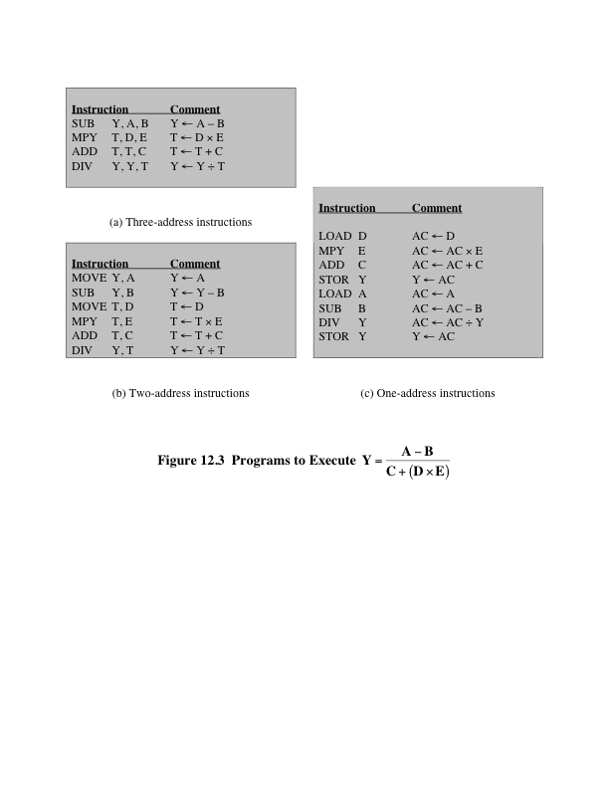
Number of Addresses
Notes:
7
Figure 12.3 compares typical one, two, and three address instructions that
could be used to compute Y = (A – B)/[C + (D * E)]. With three addresses, each instruction specifies two source operand locations and a destination operand location. Because we choose not to alter the value of any of the operand locations, a temporary location, T, is used to store some intermediate results. Note that there are four instructions and that the original expression had five operands.
Three-address instruction formats are not common because they require a relatively long instruction format to hold the three address references. With two- address instructions, and for binary operations, one address must do double duty as both an operand and a result. Thus, the instruction SUB Y, B carries out the calculation Y - B and stores the result in Y. The two-address format reduces the space requirement but also introduces some awkwardness. To avoid altering the value of an operand, a MOVE instruction is used to move one of the values to a result or temporary location before performing the operation. Our sample program expands to six instructions.
Simpler yet is the one-address instruction. For this to work, a second address must be implicit. This was common in earlier machines, with the implied address being a processor register known as the accumulator (AC). The accumulator contains one of the operands and is used to store the result. In our example, eight instructions are needed to accomplish the task.
It is, in fact, possible to make do with zero addresses for some instructions. Zero-address instructions are applicable to a special memory organization called a stack. A stack is a last-in-first-out set of locations. The stack is in a known location and, often, at least the top two elements are in processor registers. Thus, zero-address instructions would reference the top two stack elements. Stacks are described in Appendix O. Their use is explored further later in this chapter and in Chapter 13.

Slide 10

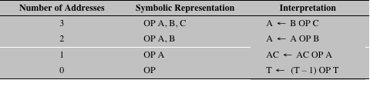
Table 12.1 Utilization of Instruction Addresses (Nonbranching Instructions)
Notes:
8
Table 12.1 summarizes the interpretations to be placed on instructions with zero, one, two, or three addresses. In each case in the table, it is assumed that the address of the next instruction is implicit, and that one operation with two source operands and one result operand is to be performed.
The number of addresses per instruction is a basic design decision. Fewer addresses per instruction result in instructions that are more primitive, requiring a less complex processor. It also results in instructions of shorter length. On the other hand, programs contain more total instructions, which in general results in longer execution times and longer, more complex programs. Also, there is an important threshold between one-address and multiple-address instructions. With one-address instructions, the programmer generally has available only one general-purpose register, the accumulator. With multiple-address instructions, it is common to have multiple general-purpose registers. This allows some operations to be performed
solely on registers. Because register references are faster than memory references, this speeds up execution. For reasons of flexibility and ability to use multiple registers, most contemporary machines employ a mixture of two- and three-address instructions.
The design trade-offs involved in choosing the number of addresses per instruction are complicated by other factors. There is the issue of whether an address references a memory location or a register. Because there are fewer registers, fewer bits are needed for a register reference. Also, as we shall see in Chapter 13, a machine may offer a variety of addressing modes, and the specification of mode takes one or more bits. The result is that most processor designs involve a variety of instruction formats.

Slide 11
Instruction Set Design
Very complex because it affects so many aspects of the computer system
Defines many of the functions performed by the processor
Programmer’s means of controlling the processor
Fundamental design issues:
Operation repertoire
How many and which operations to provide and how complex operations should be
Data types
The various types of data upon which operations are performed
Instruction format
Instruction length in bits, number of addresses, size of various fields, etc.
Registers
Number of processor registers that can be referenced by instructions and their use
Addressing
The mode or modes by which the address of an operand is specified
Notes:
9
One of the most interesting, and most analyzed, aspects of computer design is instruction set design. The design of an instruction set is very complex because it affects so many aspects of the computer system. The instruction set defines many of the functions performed by the processor and thus has a significant effect on the implementation of the processor. The instruction set is the programmer’s means of controlling the processor. Thus, programmer requirements must be considered in designing the instruction set.
It may surprise you to know that some of the most fundamental issues relating to the design of instruction sets remain in dispute. Indeed, in recent years, the level of disagreement concerning these fundamentals has actually grown. The most important of these fundamental design issues include the following:
Operation repertoire: How many and which operations to provide, and how complex operations should be
Data types: The various types of data upon which operations are performed
Instruction format: Instruction length (in bits), number of addresses, size of
various fields, and so on
Registers: Number of processor registers that can be referenced by instructions, and their use
Addressing: The mode or modes by which the address of an operand is specified
These issues are highly interrelated and must be considered together in designing an instruction set. This book, of course, must consider them in some sequence, but an attempt is made to show the interrelationships.

Slide 12
Types of Operands
Addresses
Numbers
Characters
Logical Data
Notes:
14
Machine instructions operate on data. The most important general categories of data are
Addresses
Numbers
Characters
Logical data
We shall see, in discussing addressing modes in Chapter 13, that addresses are, in fact, a form of data. In many cases, some calculation must be performed on the operand reference in an instruction to determine the main or virtual memory address. In this context, addresses can be considered to be unsigned integers.
Other common data types are numbers, characters, and logical data, and each of these is briefly examined in this section. Beyond that, some machines define specialized data types or data structures. For example, there may be machine operations that operate directly on a list or a string of characters.

Slide 13
Numbers
All machine languages include numeric data types
Numbers stored in a computer are limited:
Limit to the magnitude of numbers representable on a machine
In the case of floating-point numbers, a limit to their precision
Three types of numerical data are common in computers:
Binary integer or binary fixed point
Binary floating point
Decimal
Packed decimal
Each decimal digit is represented by a 4-bit code with two digits stored per byte
To form numbers 4-bit codes are strung together, usually in multiples of 8 bits
Notes:
All machine languages include numeric data types. Even in nonnumeric data processing, there is a need for numbers to act as counters, field widths, and so forth. An important distinction between numbers used in ordinary mathematics and numbers stored in a computer is that the latter are limited. This is true in two senses. First, there is a limit to the magnitude of numbers representable on a machine and second, in the case of floating-point numbers, a limit to their precision. Thus, the programmer is faced with understanding the consequences of rounding, overflow, and underflow.
Three types of numerical data are common in computers:
Binary integer or binary fixed point
Binary floating point
Decimal
We examined the first two in some detail in Chapter 10. It remains to say a few words about decimal numbers.
Although all internal computer operations are binary in nature, the human users of the system deal with decimal numbers. Thus, there is a necessity to convert from decimal to binary on input and from binary to decimal on output. For applications in which there is a great deal of I/O and comparatively little, comparatively simple computation, it is preferable to store and operate on the numbers in decimal form. The most common representation for this purpose is packed decimal.
With packed decimal, each decimal digit is represented by a 4-bit code, in the obvious way, with two digits stored per byte. Thus, 0 = 000, 1 = 0001, c, 8 = 1000, and 9 = 1001. Note that this is a rather inefficient code because only 10 of 16 possible 4-bit values are used. To form numbers, 4-bit codes are strung together, usually in multiples of 8 bits. Thus, the code for 246 is 0000 0010 0100 0110. This code is clearly less compact than a straight binary representation, but it avoids the con- version overhead. Negative numbers can be represented by including a 4-bit sign digit at either the left or right end of a string of packed decimal digits. Standard sign values are 1100 for positive (+) and 1101 for negative (-).
Many machines provide arithmetic instructions for performing operations directly on packed decimal numbers. The algorithms are quite similar to those described in Section 9.3 but must take into account the decimal carry operation.

Slide 14
Characters
A common form of data is text or character strings
Textual data in character form cannot be easily stored or transmitted by data processing and communications systems because they are designed for binary data
Most commonly used character code is the International Reference Alphabet (IRA)
Referred to in the United States as the American Standard Code for Information Interchange (ASCII)
Another code used to encode characters is the Extended Binary Coded Decimal Interchange Code (EBCDIC)
EBCDIC is used on IBM mainframes
Notes:
A common form of data is text or character strings. While textual data are most convenient for human beings, they cannot, in character form, be easily stored or transmitted by data processing and communications systems. Such systems are designed for binary data. Thus, a number of codes have been devised by which characters are represented by a sequence of bits. Perhaps the earliest common example of this is the Morse code. Today, the most commonly used character code in the International Reference Alphabet (IRA), referred to in the United States as the American Standard Code for Information Interchange (ASCII; see Appendix F). Each character in this code is represented by a unique 7-bit pattern; thus, 128 different characters can be represented. This is a larger number than is necessary to represent printable characters, and some of the patterns represent control characters. Some of these control characters have to do with controlling the printing of characters on a page. Others are concerned with communications procedures. IRA-encoded characters are almost always stored and transmitted using 8 bits per character. The eighth bit may be set to 0 or used as a parity bit for error detection. In the latter case, the bit is set such that the total number of binary 1s in each octet is always odd (odd parity) or always even (even parity).
Note in Table F.1 (Appendix F) that for the IRA bit pattern 011XXXX, the digits 0 through 9 are represented by their binary equivalents, 0000 through 1001, in the rightmost 4 bits. This is the same code as packed decimal. This facilitates con- version between 7-bit IRA and 4-bit packed decimal representation.
Another code used to encode characters is the Extended Binary Coded Decimal Interchange Code (EBCDIC). EBCDIC is used on IBM mainframes. It is an 8-bit code. As with IRA, EBCDIC is compatible with packed decimal. In the case of EBCDIC, the codes 11110000 through 11111001 represent the digits 0 through 9.

Slide 15
Logical Data
An n-bit unit consisting of n 1-bit items of data, each item having the value 0 or 1
Two advantages to bit-oriented view:
Memory can be used most efficiently for storing an array of Boolean or binary data items in which each item can take on only the values 1 (true) and 0 (false)
To manipulate the bits of a data item
If floating-point operations are implemented in software, we need to be able to shift significant bits in some operations
To convert from IRA to packed decimal, we need to extract the rightmost 4 bits of each byte
Notes:
Normally, each word or other addressable unit (byte, halfword, and so on) is treated as a single unit of data. It is sometimes useful, however, to consider an n-bit unit as consisting of n 1-bit items of data, each item having the value 0 or 1. When data are viewed this way, they are considered to be logical data.
There are two advantages to the bit-oriented view. First, we may sometimes wish to store an array of Boolean or binary data items, in which each item can take on only the values 1 (true) and 0 (false). With logical data, memory can be used most efficiently for this storage. Second, there are occasions when we wish to manipulate the bits of a data item. For example, if floating-point operations are implemented in software, we need to be able to shift significant bits in some operations. Another example: To convert from IRA to packed decimal, we need to extract the rightmost 4 bits of each byte.
Note that, in the preceding examples, the same data are treated sometimes as logical and other times as numerical or text. The “type” of a unit of data is deter- mined by the operation being performed on it. While this is not normally the case in high-level languages, it is almost always the case with machine language.

Slide 16
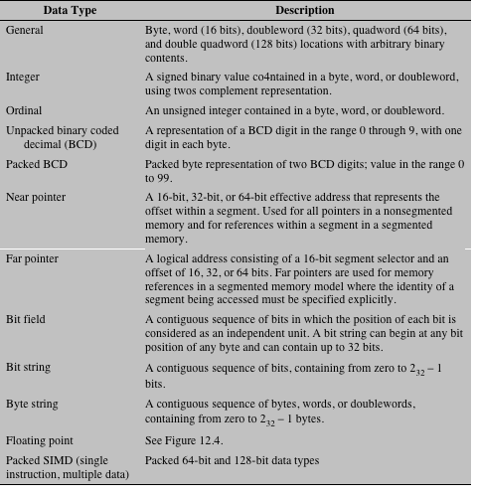
x86 Data Types
Table 12.2
x86 Data Types
Notes:
The x86 can deal with data types of 8 (byte), 16 (word), 32 (doubleword), 64 (quad- word), and 128 (double quadword) bits in length. To allow maximum flexibility in data structures and efficient memory utilization, words need not be aligned at even- numbered addresses; doublewords need not be aligned at addresses evenly divisible by 4; and quadwords need not be aligned at addresses evenly divisible by 8; and so on. However, when data are accessed across a 32-bit bus, data transfers take place in units of doublewords, beginning at addresses divisible by 4. The processor converts the request for misaligned values into a sequence of requests for the bus transfer. As with all of the Intel 80x86 machines, the x86 uses the little-endian style; that is, the least significant byte is stored in the lowest address (see Appendix 12A for a discussion of endianness).
The byte, word, doubleword, quadword, and double quadword are referred to as general data types. In addition, the x86 supports an impressive array of specific data types that are recognized and operated on by particular instructions. Table 12.2 summarizes these types.

Slide 17
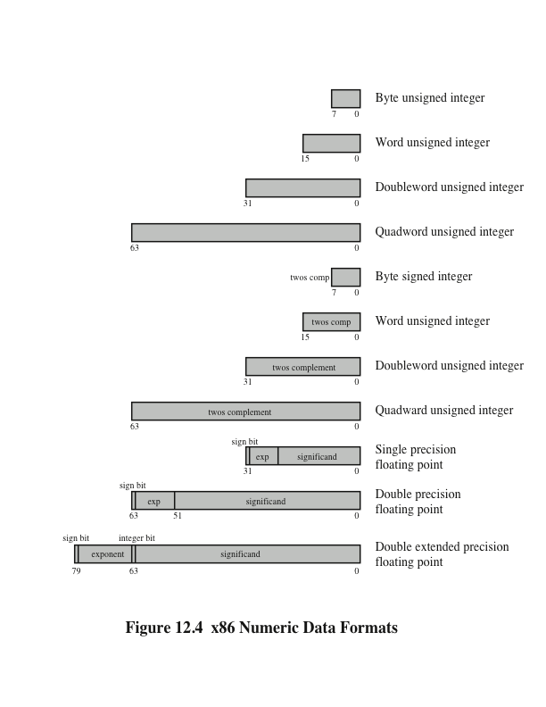
x86 Numeric Data Formats
Notes:
Figure 12.4 illustrates the x86 numerical data types. The signed integers are in twos complement representation and may be 16, 32, or 64 bits long. The floating- point type actually refers to a set of types that are used by the floating-point unit and operated on by floating-point instructions. The three floating-point representations conform to the IEEE 754 standard.

Slide 18
Single-Instruction-Multiple-Data (SIMD) Data Types
Introduced to the x86 architecture as part of the extensions of the instruction set to optimize performance of multimedia applications
These extensions include MMX (multimedia extensions) and SSE (streaming SIMD extensions)
Data types:
Packed byte and packed byte integer
Packed word and packed word integer
Packed doubleword and packed doubleword integer
Packed quadword and packed quadword integer
Packed single-precision floating-point and packed double-precision floating-point
Notes:
16
The packed SIMD (single-instruction-multiple-data) data types were introduced to the x86 architecture as part of the extensions of the instruction set to optimize performance of multimedia applications. These extensions include MMX (multimedia extensions) and SSE (streaming SIMD extensions). The basic concept is that multiple operands are packed into a single referenced memory item and that these multiple operands are operated on in parallel. The data types are as follows:
Packed byte and packed byte integer: Bytes packed into a 64-bit quadword or 128-bit double quadword, interpreted as a bit field or as an integer
Packed word and packed word integer: 16-bit words packed into a 64-bit quad- word or 128-bit double quadword, interpreted as a bit field or as an integer
• Packed doubleword and packed doubleword integer: 32-bit doublewords packed into a 64-bit quadword or 128-bit double quadword, interpreted as a bit field or as an integer
• Packed quadword and packed qaudword integer: Two 64-bit quadwords packed into a 128-bit double quadword, interpreted as a bit field or as an integer
• Packed single-precision floating-point and packed double-precision floating- point: Four 32-bit floating-point or two 64-bit floating-point values packed into a 128-bit double quadword

Slide 19
ARM Data Types
ARM processors support data types of:
8 (byte)
16 (halfword)
32 (word) bits in length
Alignment checking
When the appropriate control bit is set, a data abort signal indicates an alignment fault for attempting unaligned access
Unaligned access
When this option is enabled, the processor uses one or more memory accesses to generate the required transfer of adjacent bytes transparently to the programmer
For all three data types an unsigned interpretation is supported in which the value represents an unsigned, nonnegative integer
All three data types can also be used for twos complement signed integers
Notes:
ARM processors support data types of 8 (byte), 16 (halfword), and 32 (word) bits in length. Normally, halfword access should be halfword aligned and word accesses should be word aligned. For nonaligned access attempts, the architecture supports three alternatives.
• Default case:
– The address is treated as truncated, with address bits[1:0] treated as zero for word accesses, and address bit[0] treated as zero for halfword accesses.
– Load single word ARM instructions are architecturally defined to rotate right the word-aligned data transferred by a non word-aligned address one, two, or three bytes depending on the value of the two least significant address bits.
• Alignment checking: When the appropriate control bit is set, a data abort signal indicates an alignment fault for attempting unaligned access.
• Unaligned access: When this option is enabled, the processor uses one or more memory accesses to generate the required transfer of adjacent bytes transparently to the programmer.
For all three data types (byte, halfword, and word) an unsigned interpretation is supported, in which the value represents an unsigned, nonnegative integer. All three data types can also be used for twos complement signed integers.
The majority of ARM processor implementations do not provide floating- point hardware, which saves power and area. If floating-point arithmetic is required in such processors, it must be implemented in software. ARM does support an optional floating-point coprocessor that supports the single- and double-precision floating point data types defined in IEEE 754.

Slide 20
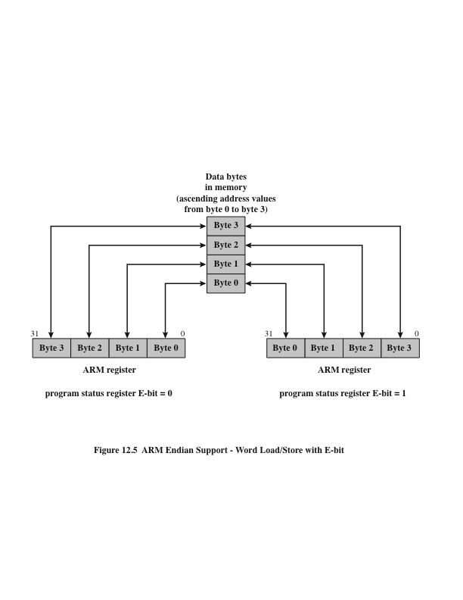
ARM Endian Support
Notes:
A state bit (E-bit) in the system control register is set and cleared under program control using the SETEND instruction. The E-bit defines which endian to load and store data. Figure 12.5 illustrates the functionality associated with the E-bit for a word load or store operation. This mechanism enables efficient dynamic data load/store for system designers who know they need to access data structures in the opposite endianness to their OS/environment. Note that the address of each data byte is fixed in memory. However, the byte lane in a register is different.

Slide 21
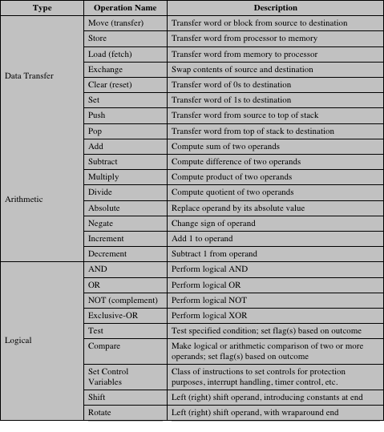
Table 12.3 Common Instruction Set Operations (page 1 of 2)
Notes:
18
The number of different opcodes varies widely from machine to machine. However, the same general types of operations are found on all machines. A useful and typical categorization is the following:
Data transfer
Arithmetic
Logical
Conversion
I/O
System control
Transfer of control
Table 12.3 (based on [HAYE98]) lists common instruction types in each category.

Slide 22
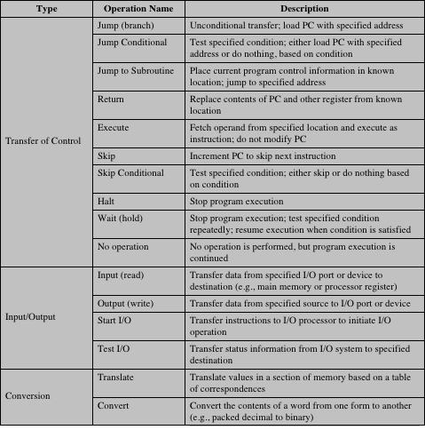
Table 12.3 Common Instruction Set Operations (page 2 of 2)
Notes:
18
Table 12.3, page 2 of 2

Slide 23
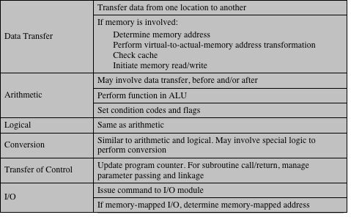
Table 12.4 Processor Actions for Various Types of Operations
Notes:
This section provides a brief survey of these various types of operations, together with a brief discussion of the actions taken by the processor to execute a particular type of operation (summarized in Table 12.4).

Slide 24
Data Transfer
Most fundamental type of machine instruction
Must specify:
Location of the source and destination operands
The length of data to be transferred must be indicated
The mode of addressing for each operand must be specified
Notes:
19
The most fundamental type of machine instruction is the data transfer instruction. The data transfer instruction must specify several things. First, the location of the source and destination operands must be specified. Each location could be memory, a register, or the top of the stack. Second, the length of data to be transferred must be indicated. Third, as with all instructions with operands, the mode of addressing for each operand must be specified. This latter point is discussed in Chapter 13.

Slide 25
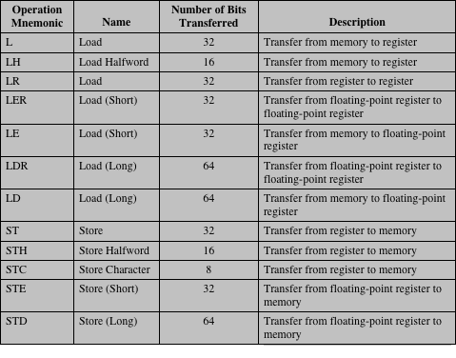
Table 12.5 Examples of IBM EAS/390 Data Transfer Operations
Notes:
The choice of data transfer instructions to include in an instruction set exemplifies the kinds of trade-offs the designer must make. For example, the general location (memory or register) of an operand can be indicated in either the specification of the opcode or the operand. Table 12.5 shows examples of the most common IBM EAS/390 data transfer instructions. Note that there are variants to indicate
the amount of data to be transferred (8, 16, 32, or 64 bits). Also, there are different instructions for register to register, register to memory, memory to register, and memory to memory transfers. In contrast, the VAX has a move (MOV) instruction with variants for different amounts of data to be moved, but it specifies whether an operand is register or memory as part of the operand. The VAX approach is some- what easier for the programmer, who has fewer mnemonics to deal with. However, it is also somewhat less compact than the IBM EAS/390 approach because the location (register versus memory) of each operand must be specified separately in the instruction.

Slide 26
Arithmetic
Most machines provide the basic arithmetic operations of add, subtract, multiply, and divide
These are provided for signed integer (fixed-point) numbers
Often they are also provided for floating-point and packed decimal numbers
Other possible operations include a variety of single-operand instructions:
Absolute
Take the absolute value of the operand
Negate
Negate the operand
Increment
Add 1 to the operand
Decrement
Subtract 1 from the operand
Notes:
20
Most machines provide the basic arithmetic operations of add, subtract, multi- ply, and divide. These are invariably provided for signed integer (fixed-point) numbers. Often they are also provided for floating-point and packed decimal numbers.
Other possible operations include a variety of single-operand instructions; for example,
• Absolute: Take the absolute value of the operand.
• Negate: Negate the operand.
• Increment: Add 1 to the operand.
• Decrement: Subtract 1 from the operand.
The execution of an arithmetic instruction may involve data transfer operations to position operands for input to the ALU, and to deliver the output of the ALU. Figure 3.5 illustrates the movements involved in both data transfer and arithmetic operations. In addition, of course, the ALU portion of the processor performs the desired operation.

Slide 27
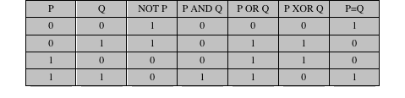
Logical
Table 12.6 Basic Logical Operations
Notes:
21
Most machines also provide a variety of operations for manipulating individual bits of a word or other addressable units, often referred to as “bit twiddling.” They are based upon Boolean operations (see Chapter 11).
Some of the basic logical operations that can be performed on Boolean or binary data are shown in Table 12.6. The NOT operation inverts a bit. AND, OR, and Exclusive-OR (XOR) are the most common logical functions with two operands. EQUAL is a useful binary test.

Slide 28
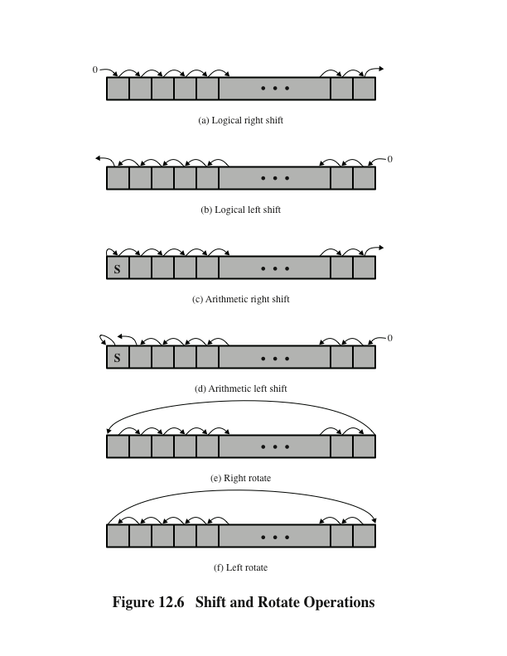
Shift and Rotate Operations
Notes:
In addition to bitwise logical operations, most machines provide a variety of shifting and rotating functions. The most basic operations are illustrated in Figure 12.6. With a logical shift, the bits of a word are shifted left or right. On one end, the bit shifted out is lost. On the other end, a 0 is shifted in. Logical shifts are useful primarily for isolating fields within a word. The 0s that are shifted into a word displace unwanted information that is shifted off the other end.

Slide 29
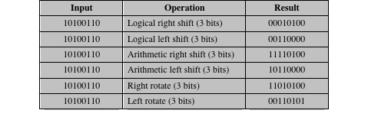
Table 12.7 Examples of Shift and Rotate Operations
Notes:
The arithmetic shift operation treats the data as a signed integer and does
not shift the sign bit. On a right arithmetic shift, the sign bit is replicated into the bit position to its right. On a left arithmetic shift, a logical left shift is performed on all bits but the sign bit, which is retained. These operations can speed up certain arithmetic operations. With numbers in twos complement notation, a right arithmetic shift corresponds to a division by 2, with truncation for odd numbers. Both an arithmetic left shift and a logical left shift correspond to a multiplication by 2 when there is no overflow. If overflow occurs, arithmetic and logical left shift operations produce different results, but the arithmetic left shift retains the sign of the number. Because of the potential for overflow, many processors do not include this instruction, including PowerPC and Itanium. Others, such as the IBM EAS/390, do offer the instruction. Curiously, the x86 architecture includes an arithmetic left shift but defines it to be identical to a logical left shift.
Rotate, or cyclic shift, operations preserve all of the bits being operated on. One use of a rotate is to bring each bit successively into the leftmost bit, where it can be identified by testing the sign of the data (treated as a number).
As with arithmetic operations, logical operations involve ALU activity and may involve data transfer operations. Table 12.7 gives examples of all of the shift and rotate operations discussed in this subsection.

Slide 30
Conversion
Instructions that change the format or operate on the format of data
An example is converting from decimal to binary
An example of a more complex editing instruction is the EAS/390 Translate (TR) instruction
Notes:
22
Conversion instructions are those that change the format or operate on the format of data. An example is converting from decimal to binary. An example of a more complex editing instruction is the EAS/390 Translate (TR) instruction. This instruction can be used to convert from one 8-bit code to another, and it takes three operands:
TR R1 (L), R2
The operand R2 contains the address of the start of a table of 8-bit codes. The L bytes starting at the address specified in R1 are translated, each byte being replaced by the contents of a table entry indexed by that byte. For example, to translate from EBCDIC to IRA, we first create a 256-byte table in storage locations, say, 1000-10FF hexadecimal. The table contains the characters of the IRA code in the sequence of the binary representation of the EBCDIC code; that is, the IRA code is placed in the table at the relative location equal to the binary value of the EBCDIC code of the same character. Thus, locations 10F0 through 10F9 will contain the values 30 through 39, because F0 is the EBCDIC code for the digit 0, and 30 is the IRA code for the digit 0, and so on through digit 9. Now suppose we have the EBCDIC for the digits 1984 starting at location 2100 and we wish to trans- late to IRA. Assume the following:
• Locations 2100–2103 contain F1 F9 F8 F4.
• R1 contains 2100.
• R2 contains 1000.
Then, if we execute
TR R1 (4), R2
locations 2100–2103 will contain 31 39 38 34.

Slide 31
Input/Output
Variety of approaches taken:
Isolated programmed I/O
Memory-mapped programmed I/O
DMA
Use of an I/O processor
Many implementations provide only a few I/O instructions, with the specific actions specified by parameters, codes, or command words
Notes:
23
Input/output instructions were discussed in some detail in Chapter 7. As we saw, there are a variety of approaches taken, including isolated programmed I/O, memory-mapped programmed I/O, DMA, and the use of an I/O processor. Many implementations provide only a few I/O instructions, with the specific actions specified by parameters, codes, or command words.

Slide 32
System Control
Instructions that can be executed only while the processor is in a certain privileged state or is executing a program in a special privileged area of memory
Typically these instructions are reserved for the use of the operating system
Examples of system control operations:
A system control instruction may read or alter a control register
An instruction to read or modify a storage protection key
Access to process control blocks in a multiprogramming system
Notes:
24
System control instructions are those that can be executed only while the processor is in a certain privileged state or is executing a program in a special privileged area of memory. Typically, these instructions are reserved for the use of the operating system.
Some examples of system control operations are as follows. A system control instruction may read or alter a control register; we discuss control registers in Chapter 14. Another example is an instruction to read or modify a storage protection key, such as is used in the EAS/390 memory system. Another example is access to process control blocks in a multiprogramming system.

Slide 33
Transfer of Control
Reasons why transfer-of-control operations are required:
It is essential to be able to execute each instruction more than once
Virtually all programs involve some decision making
It helps if there are mechanisms for breaking the task up into smaller pieces that can be worked on one at a time
Most common transfer-of-control operations found in instruction sets:
Branch
Skip
Procedure call
Notes:
25
For all of the operation types discussed so far, the next instruction to be performed is the one that immediately follows, in memory, the current instruction. However, a significant fraction of the instructions in any program have as their function changing the sequence of instruction execution. For these instructions, the operation per- formed by the processor is to update the program counter to contain the address of some instruction in memory.
There are a number of reasons why transfer-of-control operations are required. Among the most important are the following:
In the practical use of computers, it is essential to be able to execute each instruction more than once and perhaps many thousands of times. It may require thousands or perhaps millions of instructions to implement an application. This would be unthinkable if each instruction had to be written out separately. If a table or a list of items is to be processed, a program loop is needed. One sequence of instructions is executed repeatedly to process all the data.
Virtually all programs involve some decision making. We would like the computer to do one thing if one condition holds, and another thing if another condition holds. For example, a sequence of instructions computes the square root of a number. At the start of the sequence, the sign of the number is tested. If the number is negative, the computation is not performed, but an error condition is reported.
To compose correctly a large or even medium-size computer program is an exceedingly difficult task. It helps if there are mechanisms for breaking the task up into smaller pieces that can be worked on one at a time.

Slide 34
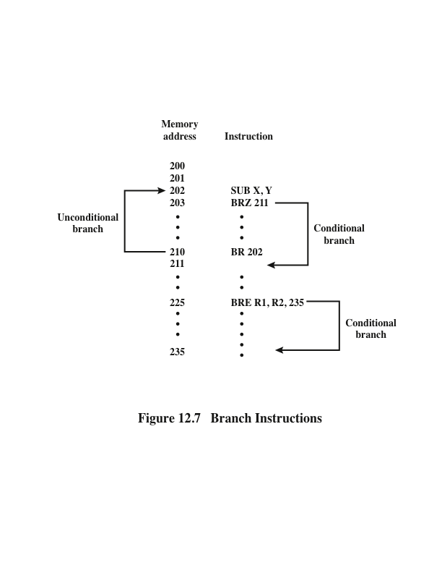
Branch Instruction
Notes:
A branch instruction, also called a jump instruction, has as one of its operands the address of the next instruction to be executed. Most often, the instruction is a conditional branch instruction. That is, the branch is made (update program counter to equal address specified in operand) only if a certain condition is met. Otherwise, the next instruction in sequence is executed (increment program counter as usual). A branch instruction in which the branch is always taken is an unconditional branch.
Figure 12.7 shows examples of these operations. Note that a branch can be either forward (an instruction with a higher address) or backward (lower address). The example shows how an unconditional and a conditional branch can be used to create a repeating loop of instructions. The instructions in locations 202 through 210 will be executed repeatedly until the result of subtracting Y from X is 0.

Slide 35
Skip Instructions
Includes an implied address
Typically implies that one instruction be skipped, thus the implied address equals the address of the next instruction plus one instruction length
Because the skip instruction does not require a destination address field it is free to do other things
Example is the increment-and-skip-if-zero (ISZ) instruction
Notes:
Another form of transfer-of-control instruction is the skip instruction. The skip instruction includes an implied address. Typically, the skip implies that one instruction be skipped; thus, the implied address equals the address of the next instruction plus one instruction length.
Because the skip instruction does not require a destination address field, it is free to do other things. A typical example is the increment-and-skip-if-zero (ISZ) instruction.

Slide 36
Procedure Call Instructions
Self-contained computer program that is incorporated into a larger program
At any point in the program the procedure may be invoked, or called
Processor is instructed to go and execute the entire procedure and then return to the point from which the call took place
Two principal reasons for use of procedures:
Economy
A procedure allows the same piece of code to be used many times
Modularity
Involves two basic instructions:
A call instruction that branches from the present location to the procedure
Return instruction that returns from the procedure to the place from which it was called
Notes:
Perhaps the most important innovation in the development of programming languages is the procedure. A procedure is a self- contained computer program that is incorporated into a larger program. At any point in the program the procedure may be invoked, or called. The processor is instructed to go and execute the entire procedure and then return to the point from which the call took place.
The two principal reasons for the use of procedures are economy and modularity. A procedure allows the same piece of code to be used many times. This is important for economy in programming effort and for making the most efficient use of storage space in the system (the program must be stored). Procedures also allow large programming tasks to be subdivided into smaller units. This use of modularity greatly eases the programming task.
The procedure mechanism involves two basic instructions: a call instruction that branches from the present location to the procedure, and a return instruction that returns from the procedure to the place from which it was called. Both of these are forms of branching instructions.

Slide 37
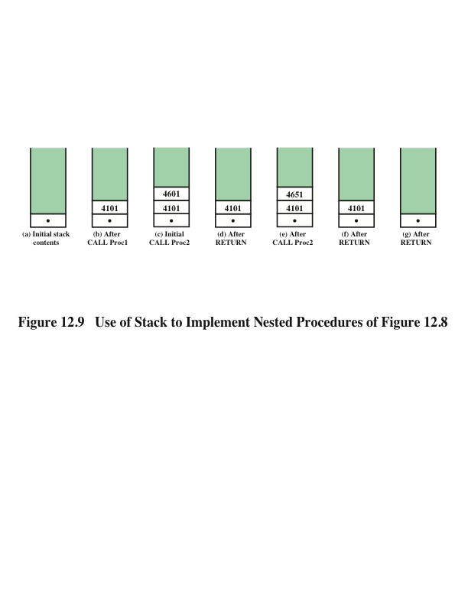
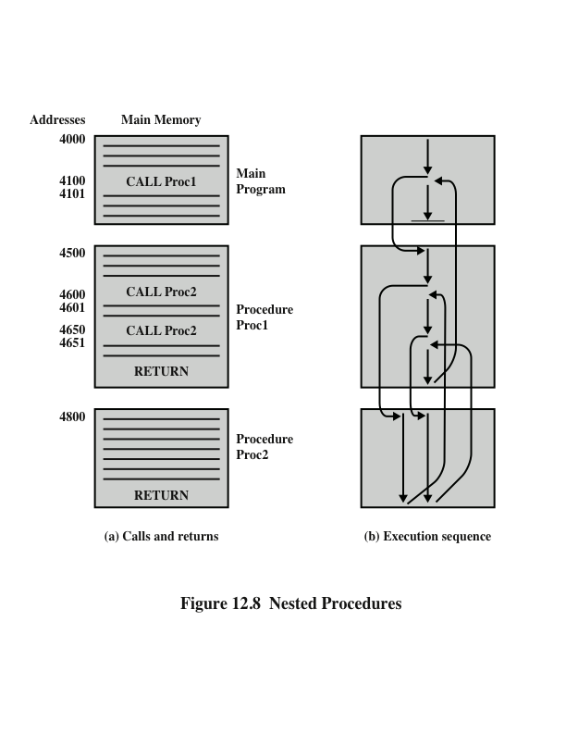
Nested Procedures
Notes:
Figure 12.8a illustrates the use of procedures to construct a program. In this example, there is a main program starting at location 4000. This program includes a call to procedure PROC1, starting at location 4500. When this call instruction is encountered, the processor suspends execution of the main program and begins execution of PROC1 by fetching the next instruction from location 4500. Within PROC1, there are two calls to PROC2 at location 4800. In each case, the execution of PROC1 is suspended and PROC2 is executed. The RETURN statement causes the processor to go back to the calling program and continue execution at the instruction after the corresponding CALL instruction. This behavior is illustrated in Figure 12.8b.

Slide 38
Use of Stack to Implement Nested Procedures
Notes:
A more general and powerful approach is to use a stack (see Appendix O for a discussion of stacks). When the processor executes a call, it places the return address on the stack. When it executes a return, it uses the address on the stack.
Figure 12.9 illustrates the use of the stack.

Slide 39
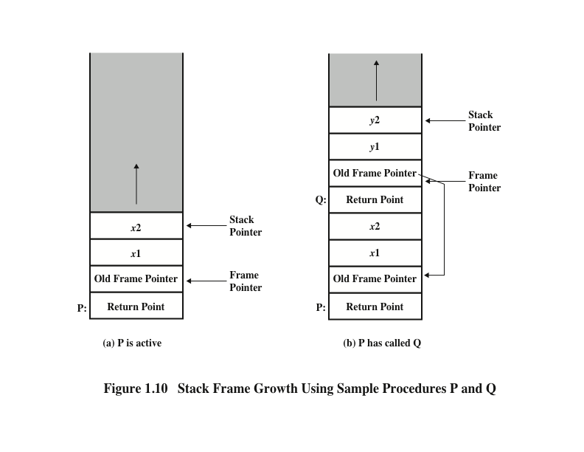
Stack Frame Growth Using Sample Procedures P and Q
Notes:
A more flexible approach to parameter passing is the stack. When the processor executes a call, it not only stacks the return address, it stacks parameters to be passed to the called procedure. The called procedure can access the parameters from the stack. Upon return, return parameters can also be placed on the stack. The entire set of parameters, including return address, that is stored for a procedure invocation is referred to as a stack frame.
An example is provided in Figure 12.10. The example refers to procedure P in which the local variables x1 and x2 are declared, and procedure Q, which P can call and in which the local variables y1 and y2 are declared. In this figure, the return point for each procedure is the first item stored in the corresponding stack frame. Next is stored a pointer to the beginning of the previous frame. This is needed if the number or length of parameters to be stacked is variable.

Slide 40
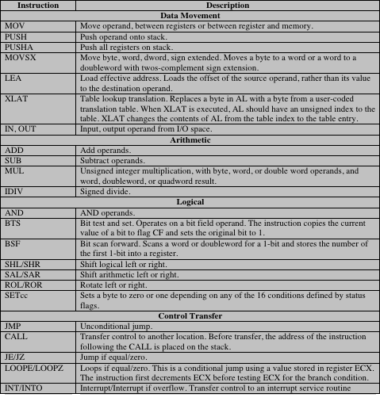
Table 12.8
x86
Operation Types (With Examples of Typical Operations)
(page 1 of 2)
Notes:
27
The x86 provides a complex array of operation types, including a number of specialized instructions. The intent was to provide tools for the compiler writer to produce optimized machine language translation of high-level language programs. Table 12.8 lists the types and gives examples of each. Most of these are the conventional instructions found in most machine instruction sets, but several types of instructions are tailored to the x86 architecture and are of particular interest.

Slide 41
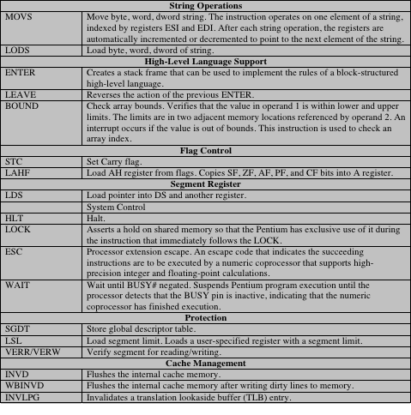
Table 12.8
x86
Operation Types (With Examples of Typical Operations)
(page 2 of 2)
Notes:
28
Table 12.8 – page 2

Slide 42
Call/Return Instructions
The x86 provides four instructions to support procedure call/return:
CALL
ENTER
LEAVE
RETURN
Common means of implementing the procedure is via the use of stack frames
The CALL instruction pushes the current instruction pointer value onto the stack and causes a jump to the entry point of the procedure by placing the address of the entry point in the instruction pointer
The ENTER instruction was added to the instruction set to provide direct support for the compiler
Notes:
29
he x86 provides four instructions to support procedure call/return: CALL, ENTER, LEAVE, RETURN. It will be instructive to look at the support provided by these instructions. Recall from Figure 12.10 that a common means of implementing the procedure call/return mechanism is via the use of stack frames. When a new procedure is called, the following must be performed upon entry to the new procedure:
• Push the return point on the stack.
• Push the current frame pointer on the stack.
• Copy the stack pointer as the new value of the frame pointer. • Adjust the stack pointer to allocate a frame.
The CALL instruction pushes the current instruction pointer value onto the stack and causes a jump to the entry point of the procedure by placing the address of the entry point in the instruction pointer.
The ENTER instruction was added to the instruction set to provide direct sup- port for the compiler. The instruction also includes a feature for support of what are called nested procedures in languages such as Pascal, COBOL, and Ada (not found in C or FORTRAN). It turns out that there are better ways of handling nested procedure calls for these languages. Furthermore, although the ENTER instruction saves a few bytes of memory compared with the PUSH, MOV, SUB sequence (4 bytes versus 6 bytes), it actually takes longer to execute (10 clock cycles versus 6 clock cycles). Thus, although it may have seemed a good idea to the instruction set designers to add this feature, it complicates the implementation of the processor while providing little or no benefit. We will see that, in contrast, a RISC approach to processor design would avoid complex instructions such as ENTER and might
produce a more efficient implementation with a sequence of simpler instructions.

Slide 43
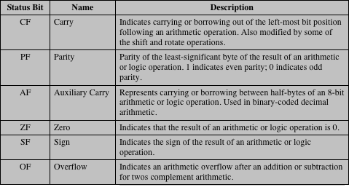
x86 Status Flags
Notes:
Status flags are bits in special registers that may be set by certain operations and used in conditional branch instructions. The term condition code refers to the settings of one or more status flags. In the x86 and many other architectures, status flags are set by arithmetic and compare operations. The compare operation in most languages subtracts two operands, as does a subtract operation. The difference is that a compare operation only sets status flags, whereas a subtract operation also stores the result of the subtraction in the destination operand. Some architectures also set status flags for data transfer instructions.
Table 12.9 lists the status flags used on the x86. Each flag, or combinations of these flags, can be tested for a conditional jump.

Slide 44
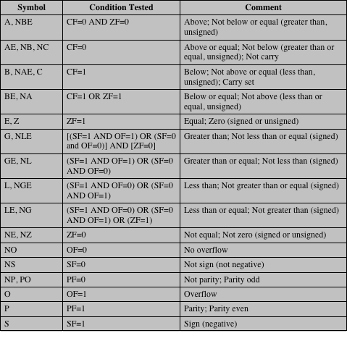
Table 12.10 x86 Condition Codes for Conditional Jump and SETcc Instructions
Notes:
Table 12.10 shows the condition codes (combinations of status flag values) for which conditional jump opcodes have been defined.

Slide 45
x86 Single-Instruction, Multiple-Data (SIMD) Instructions
1996 Intel introduced MMX technology into its Pentium product line
MMX is a set of highly optimized instructions for multimedia tasks
Video and audio data are typically composed of large arrays of small data types
Three new data types are defined in MMX
Packed byte
Packed word
Packed doubleword
Each data type is 64 bits in length and consists of multiple smaller data fields, each of which holds a fixed-point integer
Notes:
30
In 1996, Intel introduced MMX technology into its Pentium product line. MMX is set of highly optimized instructions for multimedia tasks. There are 57 new instructions that treat data in a SIMD (single-instruction, multiple- data) fashion, which makes it possible to perform the same operation, such as addition or multiplication, on multiple data elements at once. Each instruction typically takes a single clock cycle to execute. For the proper application, these fast parallel operations can yield a speedup of two to eight times over comparable algorithms that do not use the MMX instructions [ATKI96]. With the introduction of 64-bit x86 architecture, Intel has expanded this extension to include double quadword (128 bits) operands and floating-point operations. In this subsection, we describe the MMX features.
The focus of MMX is multimedia programming. Video and audio data are typically composed of large arrays of small data types, such as 8 or 16 bits, whereas conventional instructions are tailored to operate on 32- or 64-bit data. Here are some examples: In graphics and video, a single scene consists of an array of pixels, and there are 8 bits for each pixel or 8 bits for each pixel color component (red, green, blue). Typical audio samples are quantized using 16 bits. For some 3D graphics algorithms, 32 bits are common for basic data types. To provide for parallel operation on these data lengths, three new data types are defined in MMX. Each data type is 64 bits in length and consists of multiple smaller data fields, each of which holds a fixed-point integer. The types are as follows:
Packed byte: Eight bytes packed into one 64-bit quantity
Packed word: Four 16-bit words packed into 64 bits
Packed doubleword: Two 32-bit doublewords packed into 64 bits

Slide 46
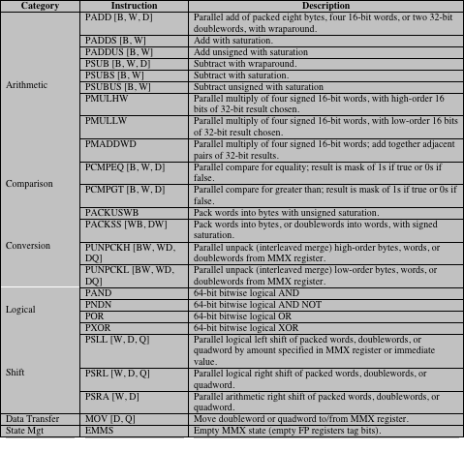
MMX Instruction Set
Note: If an instruction supports multiple data types [byte (B), word (W), doubleword (D), quadword (Q)], the data types are indicated in brackets.
Notes:
Table 12.11 lists the MMX instruction set. Most of the instructions involve parallel operation on bytes, words, or doublewords. For example, the PSLLW instruction performs a left logical shift separately on each of the four words in the packed word operand; the PADDB instruction takes packed byte operands as input and performs parallel additions on each byte position independently to produce a packed byte output.

Slide 47
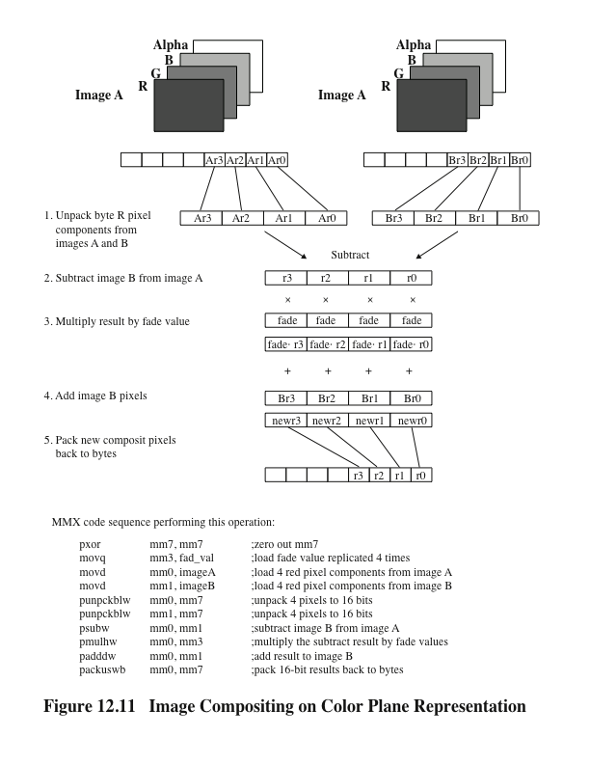
Image Compositing on Color Plane Representation
Notes:
Figure 12.11 shows the sequence of steps required for one set of pixels. The 8-bit pixel components are converted to 16-bit elements to accommodate the MMX 16-bit multiply capability. If these images use 640 * 480 resolution, and the dissolve technique uses all 255 possible values of the fade value, then the total number of instructions executed using MMX is 535 million. The same calculation, performed without the MMX instructions, requires 1.4 billion instruction executions [INTE98].

Slide 48
ARM Operation Types
Load and store instructions
Branch instructions
Data-processing instructions
Multiply instructions
Parallel addition and subtraction instructions
Extend instructions
Status register access instructions
Notes:
The ARM architecture provides a large collection of operation types. The following
are the principal categories:
Load and store instructions: In the ARM architecture, only load and store instructions access memory locations; arithmetic and logical instructions are performed only on registers and immediate values encoded in the instruction. This limitation is characteristic of RISC design and it is explored further in Chapter 15. The ARM architecture supports two broad types of instruction that load or store the value of a single register, or a pair of registers, from or to memory: (1) load or store a 32-bit word or an 8-bit unsigned byte, and (2) load or store a 16-bit unsigned halfword, and load and sign extend a 16-bit halfword or an 8-bit byte.
Branch instructions: ARM supports a branch instruction that allows a conditional branch forwards or backwards up to 32 MB. As the program counter is one of the general-purpose registers (R15), a branch or jump can also be generated by writing a value to R15. A subroutine call can be performed by a variant of the standard branch instruction. As well as allowing a branch forward or backward up to 32 MB, the Branch with Link (BL) instruction preserves the address of the instruction after the branch (the return address) in the LR (R14). Branches are determined by a 4-bit condition field in the instruction.
Data-processing instructions: This category includes logical instructions (AND, OR, XOR), add and subtract instructions, and test and compare instructions.
Multiply instructions: The integer multiply instructions operate on word or halfword operands and can produce normal or long results. For example, there is a multiply instruction that takes two 32-bit operands and produces a 64-bit result.
Parallel addition and subtraction instructions: In addition to the normal data processing and multiply instructions, there are a set of parallel addition and subtraction instructions, in which portions of two operands are operated on in parallel. For example, ADD16 adds the top halfwords of two registers to form the top halfword of the result and adds the bottom halfwords of the same two registers to form the bottom halfword of the result. These instructions are useful in image processing applications, similar to the x86 MMX instructions.
Extend instructions: There are several instructions for unpacking data by sign or zero extending bytes to halfwords or words, and halfwords to words.
Status register access instructions: ARM provides the ability to read and also to write portions of the status register.

Slide 49
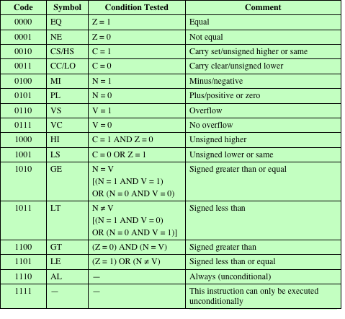
ARM Conditions for Conditional Instruction Execution
Notes:
The ARM architecture defines four condition flags that are stored in the program status register: N, Z, C, and V (Negative, Zero, Carry and Overflow), with meanings essentially the same as the S, Z, C, and V flags
in the x86 architecture. These four flags constitute a condition code in ARM. Table 12.12 shows the combination of conditions for which conditional execution is defined.
There are two unusual aspects to the use of condition codes in ARM:
All instructions, not just branch instructions, include a condition code field, which means that virtually all instructions may be conditionally executed. Any combination of flag settings except 1110 or 1111 in an instruction’s condition code field signifies that the instruction will be executed only if the condition is met.
All data processing instructions (arithmetic, logical) includes an S bit that signifies whether the instruction updates the condition flags.
The use of conditional execution and conditional setting of the condition flags
helps in the design of shorter programs that use less memory. On the other hand, all instructions include 4 bits for the condition code, so there is a trade-off in that fewer bits in the 32-bit instruction are available for opcode and operands. Because the ARM is a RISC design that relies heavily on register addressing, this seems to be a reasonable trade-off.

Slide 50
Summary
Instruction Sets:
Characteristics and Functions
Chapter 12
Intel x86 and ARM data types
Types of operations
Data transfer
Arithmetic
Logical
Conversion
Input/output
System control
Transfer of control
Intel x86 and ARM operation types
Machine instruction characteristics
Elements of a machine instruction
Instruction representation
Instruction types
Number of addresses
Instruction set design
Types of operands
Numbers
Characters
Logical data
Notes:
Chapter 12 summary.

